Slide 1
Blink an LED

Slide 2
Aim
Blink an LED with a blink delay of 1 second (1000 ms) using Arduino

Slide 3
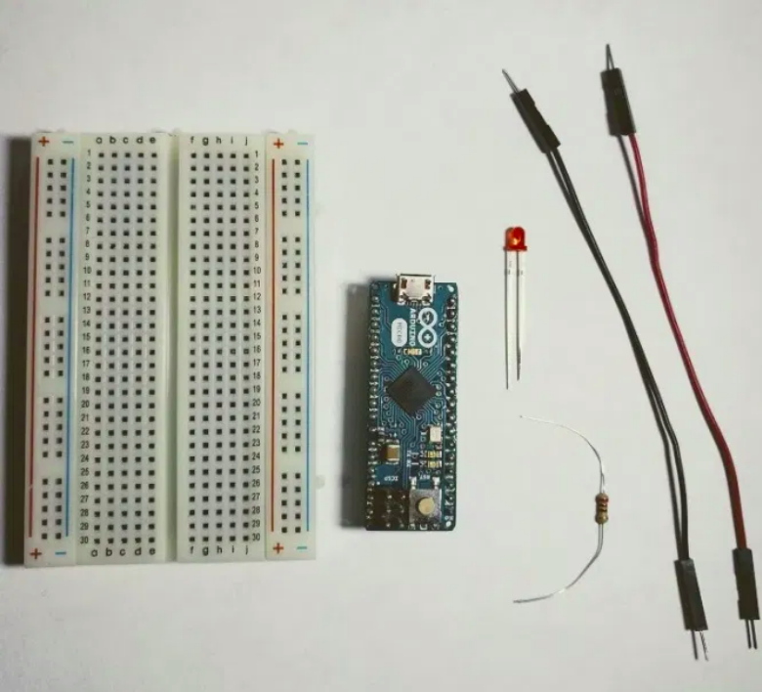
Parts Needed
Arduino Uno
LED
USB A-to-B Cable
Breadboard
LED 5mm
220 Ohm Resistor
Jumper Wires

Slide 4
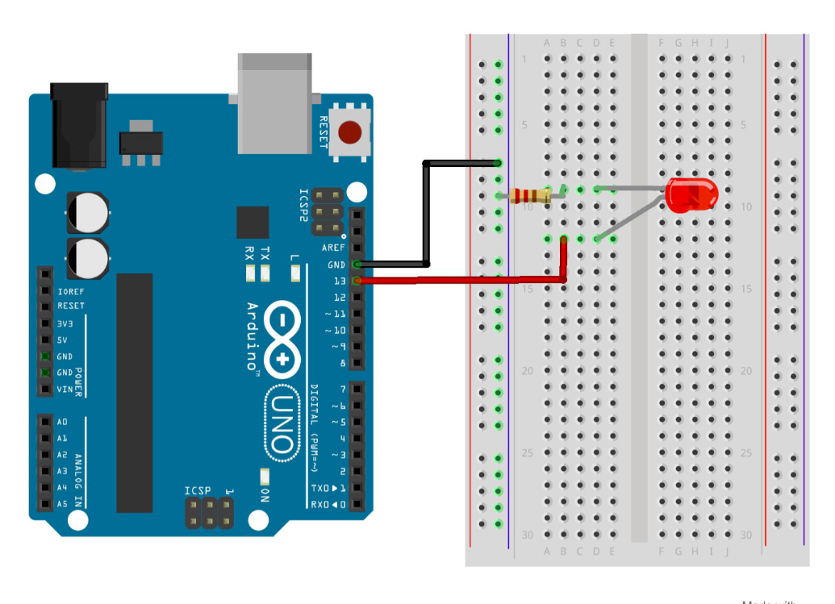
Project Diagram

Slide 5
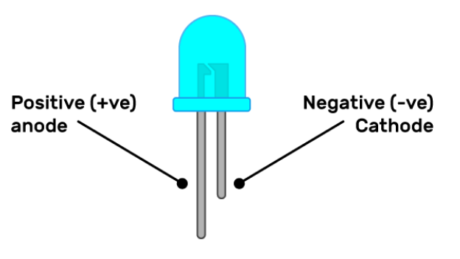
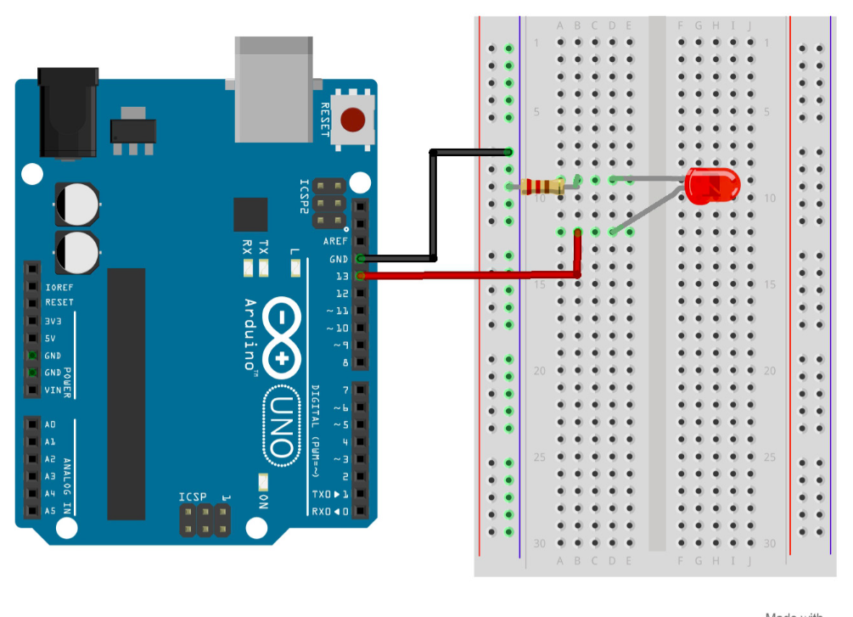
Setup
Make connections as shown in diagram, making sure the cathode is connected to ground of the terminal and anode to pin 13

Slide 6
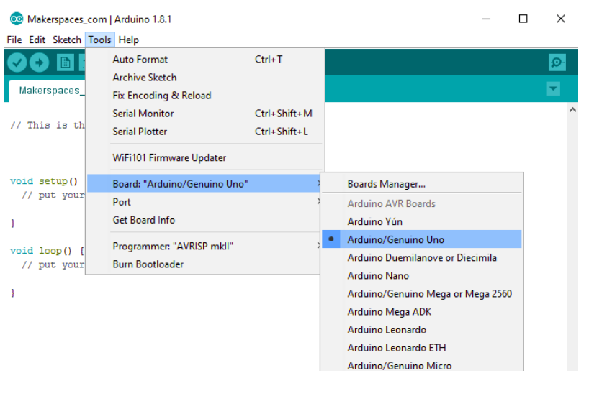
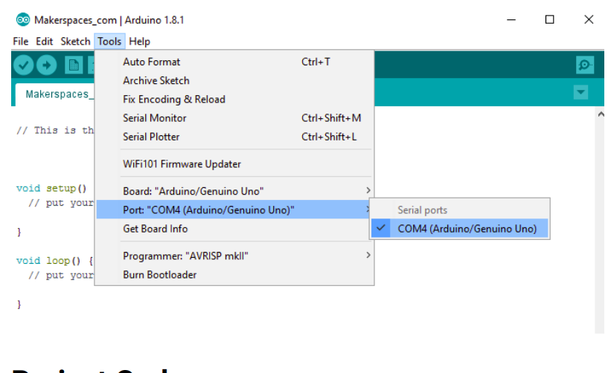
2. Select board and serial port in IDE after connecting Arduino to computer
Select Board
Select Port

Slide 7
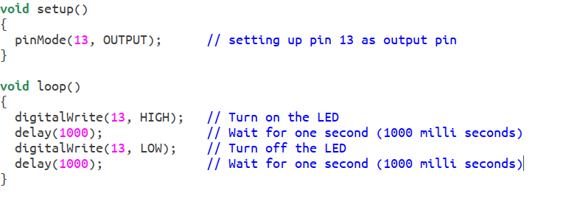
3. Upload the code file :-

Slide 8
Result

Slide 9
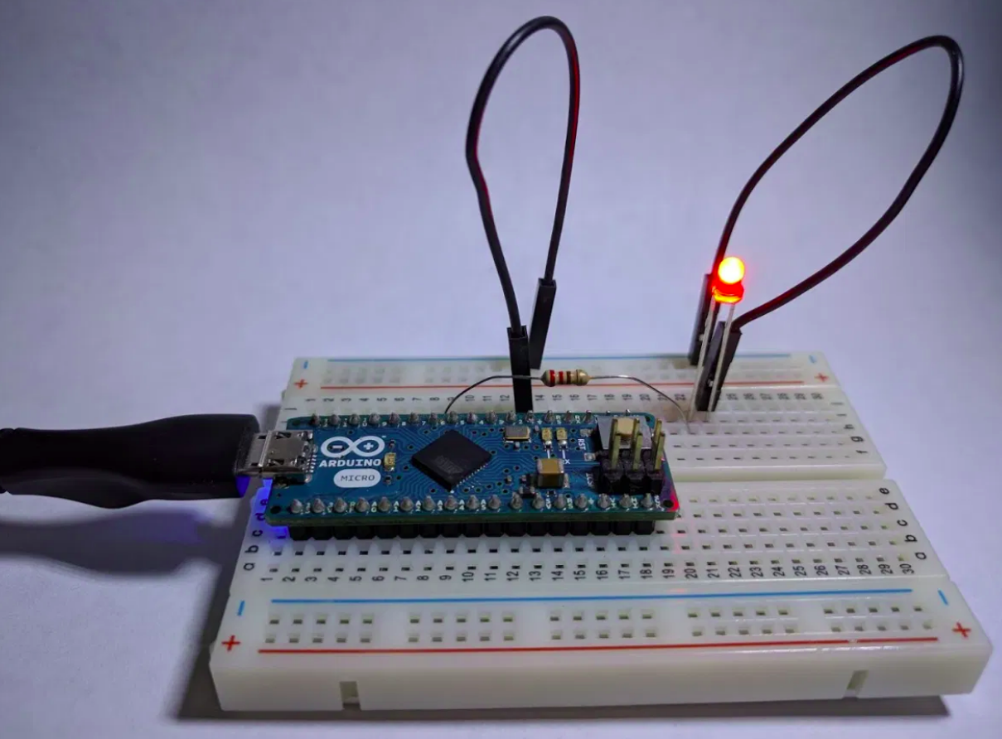

Slide 10
Thank you

